Slide 1



7: Optimal PLANTS VS. ZOMBIES STRATEGY
204ver
Chuyang Li, GAOYUAN BAO, Allen Zhang, RUNDONG YU

Slide 2


Main IDEAS for plants vs. zombies
Plants vs. Zombies is a video game. Players can quickly and effectively block zombies on the road of invasion by arming a variety of plants to switch different functions.
This model shows the plants that should be used when corresponding to different zombies, and the combinations that should be used when multiple zombies are present.

Slide 3
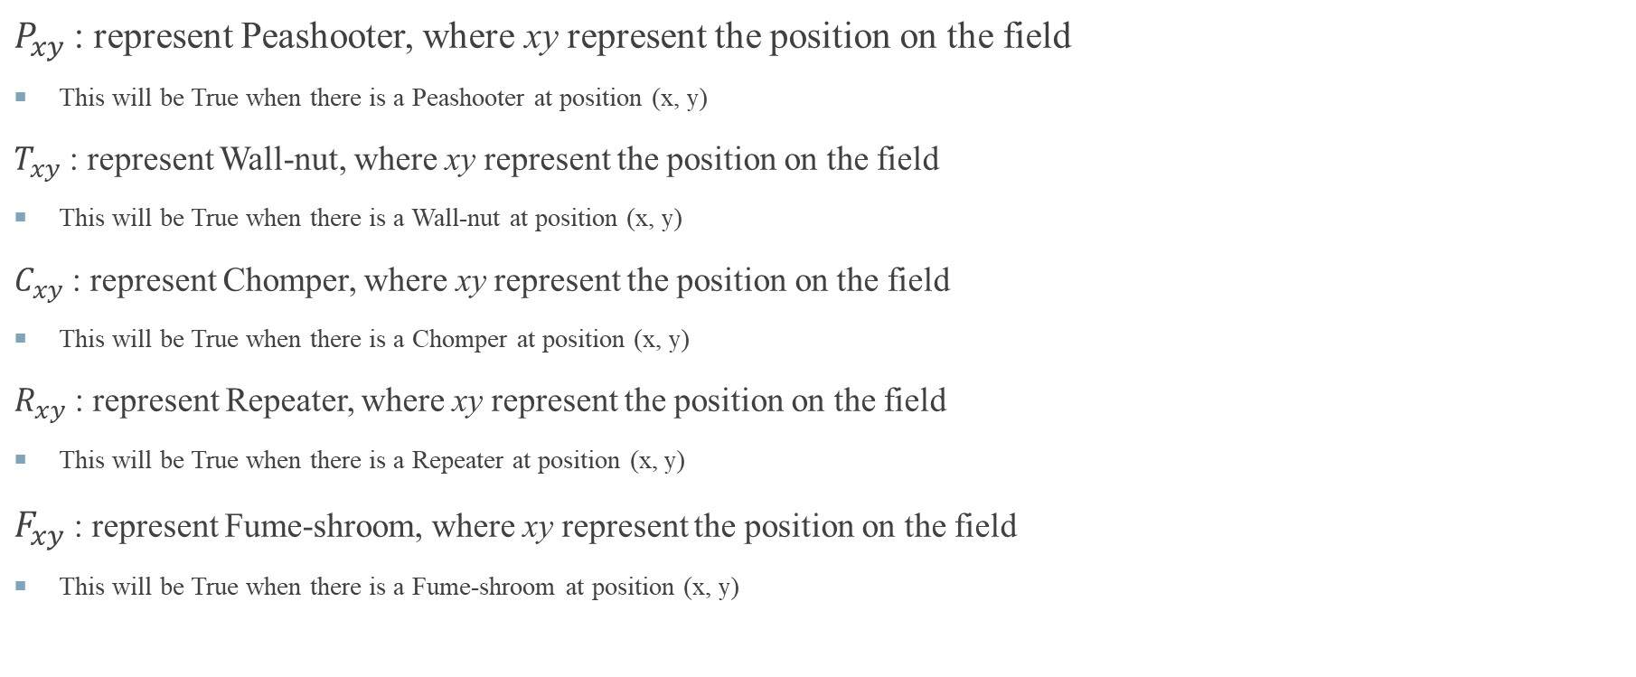
Position
$P_{xy}$: represent Peashooter, where xy represent the position on the field
This will be True when there is a Peashooter at position (x, y)
$T_{xy}$: represent Wall-nut, where xy represent the position on the field
This will be True when there is a Wall-nut at position (x, y)
$C_{xy}$: represent Chomper, where xy represent the position on the field
This will be True when there is a Chomper at position (x, y)
$R_{xy}$: represent Repeater, where xy represent the position on the field
This will be True when there is a Repeater at position (x, y)
$F_{xy}$: represent Fume-shroom, where xy represent the position on the field
This will be True when there is a Fume-shroom at position (x, y)

Slide 4
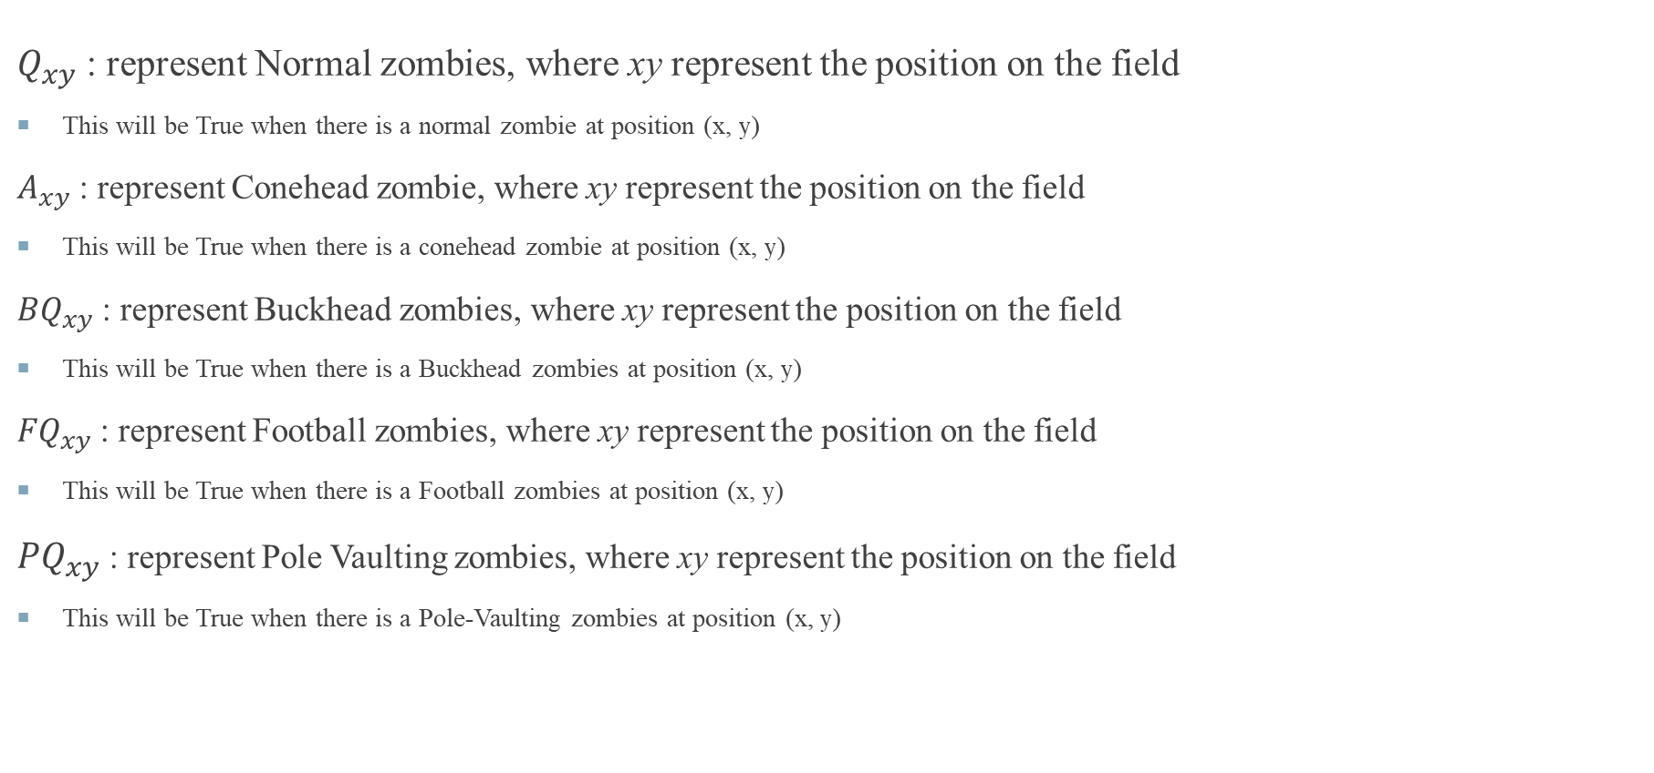
Position
$Q_{xy}$: represent Normal zombies, where xy represent the position on the field
This will be True when there is a normal zombie at position (x, y)
$A_{xy}$: represent Conehead zombie, where xy represent the position on the field
This will be True when there is a conehead zombie at position (x, y)
${BQ}_{xy}$: represent Buckhead zombies, where xy represent the position on the field
This will be True when there is a Buckhead zombies at position (x, y)
${FQ}_{xy}$: represent Football zombies, where xy represent the position on the field
This will be True when there is a Football zombies at position (x, y)
${PQ}_{xy}$: represent Pole Vaulting zombies, where xy represent the position on the field
This will be True when there is a Pole-Vaulting zombies at position (x, y)

Slide 5
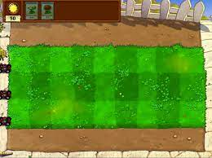
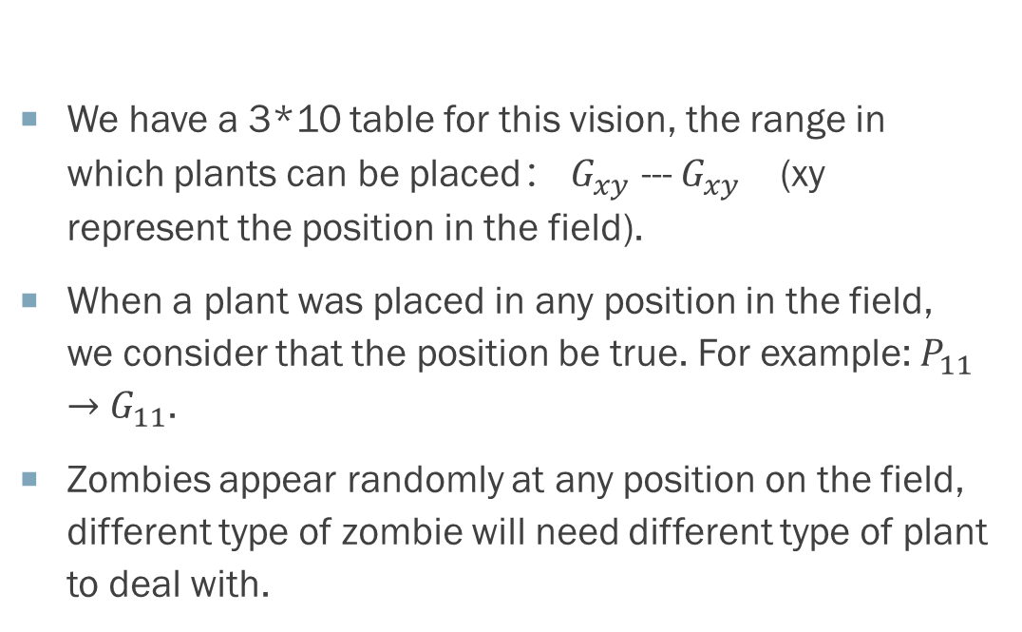
Basic table/rules
We have a 3*10 table for this vision, the range in which plants can be placed： $G_{xy}$ --- $G_{xy}$ (xy represent the position in the field).
When a plant was placed in any position in the field, we consider that the position be true. For example: $P_{11}$ $→$ $G_{11}$.
Zombies appear randomly at any position on the field, different type of zombie will need different type of plant to deal with.

Slide 6
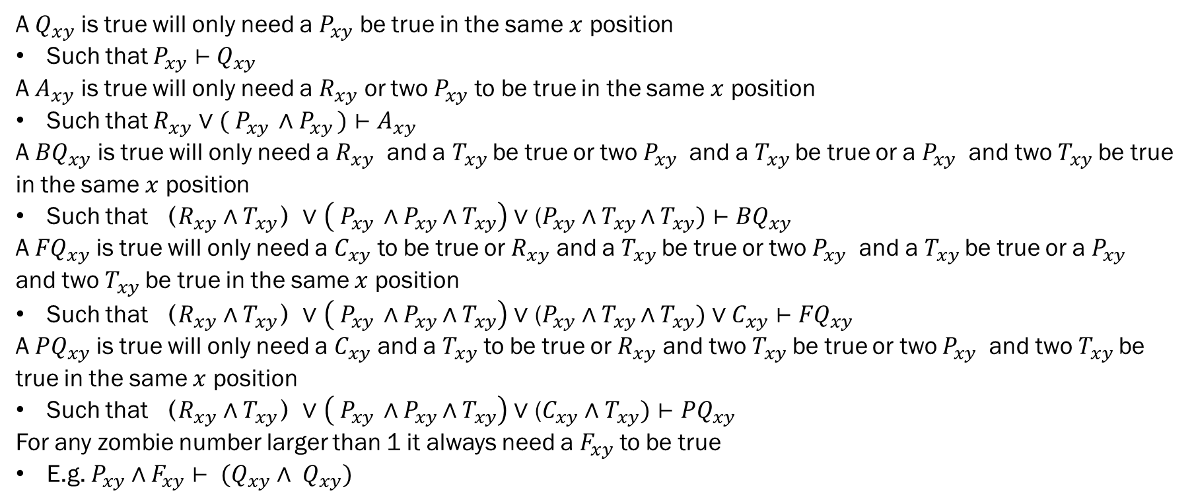
Constraints
A $Q_{xy}$ is true will only need a $P_{xy}$ be true in the same $x$ position
Such that $P_{xy}⊢{ Q}_{xy}$
A $A_{xy}$ is true will only need a $R_{xy}$ or two $P_{xy}$ to be true in the same $x$ position
Such that $R_{xy}$ ∨ $({ P}_{xy } \text{∧}{ P}_{xy })⊢$ $A_{xy}$
A ${BQ}_{xy}$ is true will only need a $R_{xy}$ and a $T_{xy}$be true or two $P_{xy}$ and a $T_{xy}$be true or a $P_{xy}$ and two $T_{xy}$be true in the same $x$ position
Such that $（R_{xy} \text{∧} T_{xy}）$∨ $\left({ P}_{xy } \text{∧}{ P}_{xy }\text{∧}{ T}_{xy}\right) \text{∨}\text{ (}P_{xy} \text{∧}{ T}_{xy }\text{∧}{ T}_{xy})⊢$ ${BQ}_{xy}$
A ${FQ}_{xy}$ is true will only need a $C_{xy}$ to be true or $R_{xy}$ and a $T_{xy}$be true or two $P_{xy}$ and a $T_{xy}$be true or a $P_{xy}$ and two $T_{xy}$be true in the same $x$ position
Such that $（R_{xy} \text{∧} T_{xy}）$∨ $\left({ P}_{xy } \text{∧}{ P}_{xy }\text{∧}{ T}_{xy}\right) \text{∨}\text{ (}P_{xy} \text{∧}{ T}_{xy }\text{∧}{ T}_{xy}) \text{∨}{ C}_{xy}⊢$ ${FQ}_{xy}$
A ${PQ}_{xy}$ is true will only need a $C_{xy}$ and a $T_{xy}$ to be true or $R_{xy}$ and two $T_{xy}$be true or two $P_{xy}$ and two $T_{xy}$be true in the same $x$ position
Such that $（R_{xy} \text{∧} T_{xy}）$∨ $\left({ P}_{xy } \text{∧}{ P}_{xy }\text{∧}{ T}_{xy}\right) \text{∨}\text{ (}C_{xy}$ $\text{∧}{ T}_{xy})⊢{PQ}_{xy}$
For any zombie number larger than 1 it always need a $F_{xy}$ to be true
E.g. $P_{xy} \text{∧}{ F}_{xy}⊢{ (Q}_{xy} \text{∧}$ ${ Q}_{xy})$

Slide 7
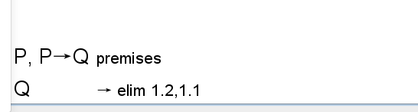
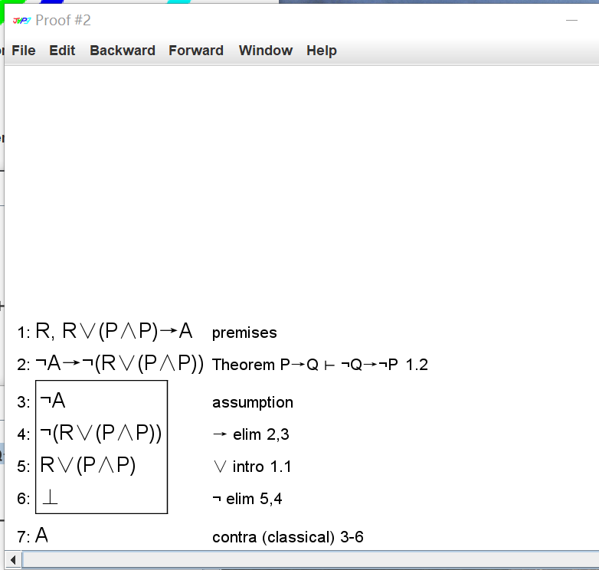
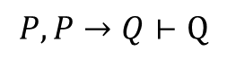
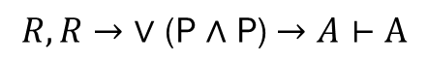
Jape Proof
$$P,P→Q⊢Q$$
$$R,R→\text{∨}\text{ (}\text{P}\text{ ∧ }\text{P}\text{)}→A⊢A$$

Slide 8
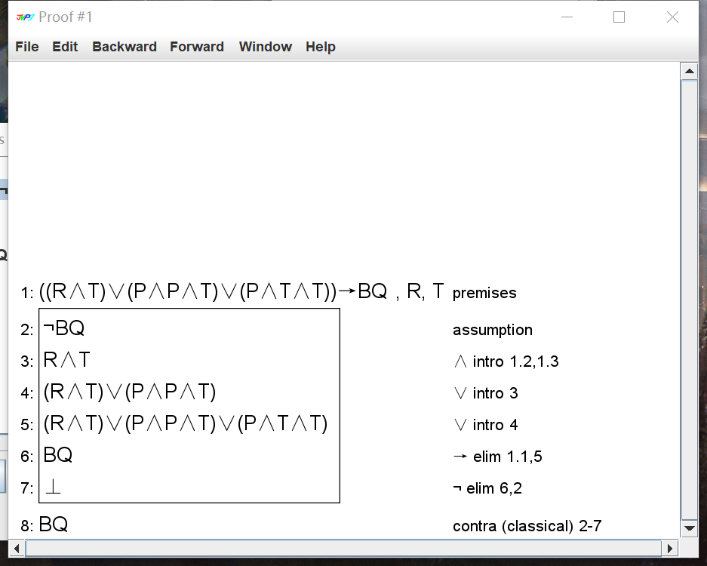
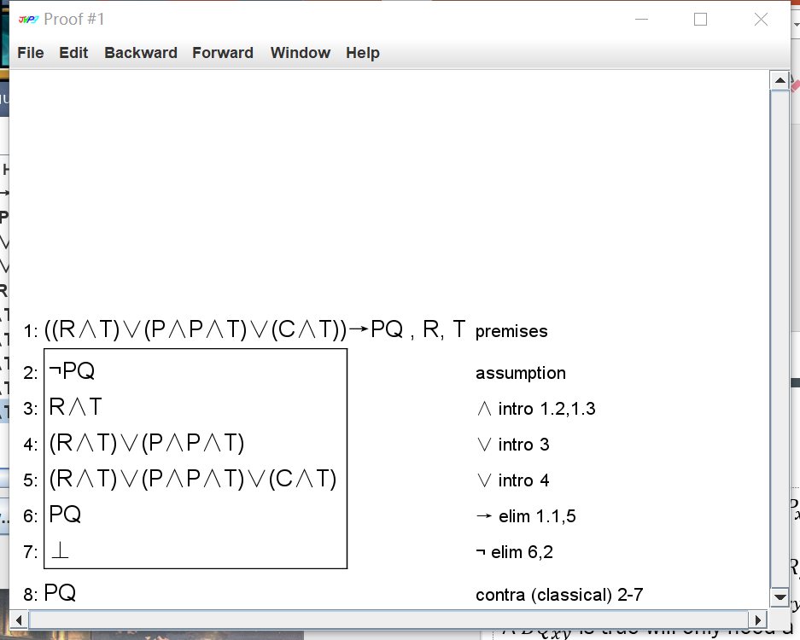
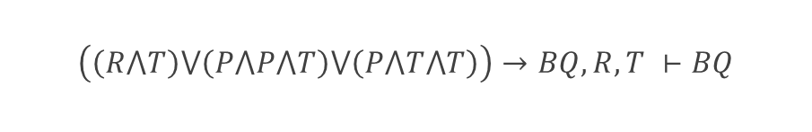

Jape Proof
$$\left(\left(R⋀T\right)⋁\left(P⋀P⋀T\right)⋁\left(P⋀T⋀T\right)\right)→BQ, R, T ⊢BQ$$
$$\left(\left(R⋀T\right)⋁\left(P⋀P⋀T\right)⋁\left(C⋀T\right)\right)→PQ, R, T⊢PQ$$

Slide 9
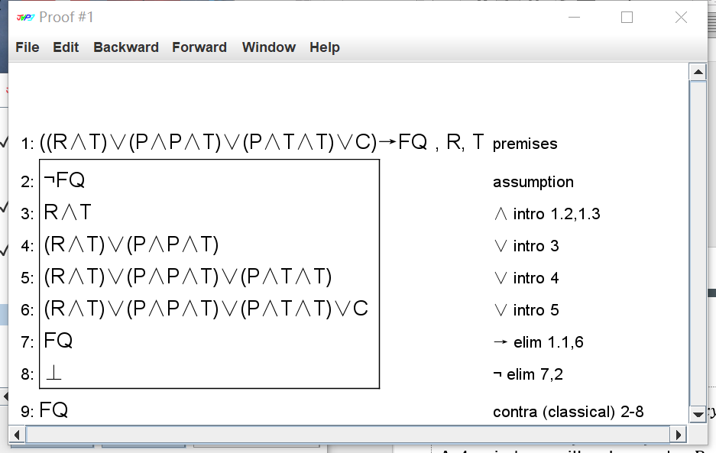
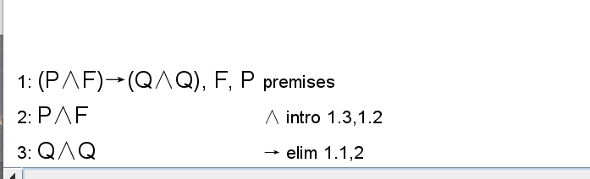

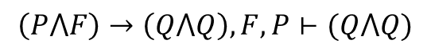
Jape Proof
$$\left(\left(R⋀T\right)⋁\left(P⋀P⋀T\right)⋁\left(P⋀T⋀T\right)⋁C\right)→FQ, R, T⊢FQ$$
$$\left(P⋀F\right)→\left(Q⋀Q\right),F,P⊢(Q⋀Q)$$

Slide 10
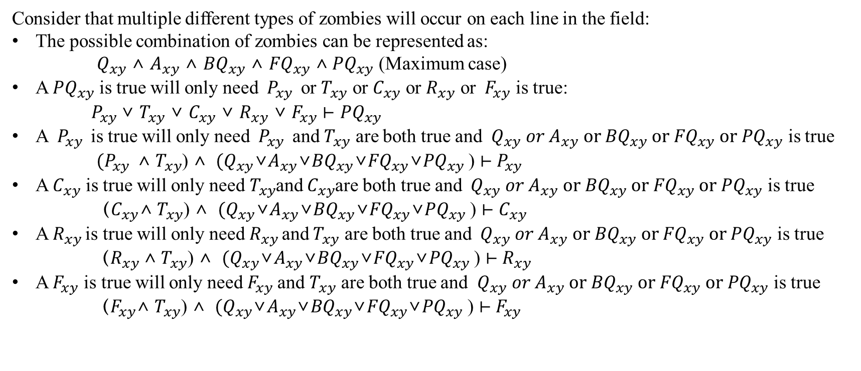
Constraints
Consider that multiple different types of zombies will occur on each line in the field:
The possible combination of zombies can be represented as:
${ Q}_{xy}$ $\text{∧}$ $A_{xy}$ $\text{∧}$ ${BQ}_{xy}$ $\text{∧}$ ${FQ}_{xy} \text{∧}$ ${PQ}_{xy}$ (Maximum case)
A ${PQ}_{xy}$ is true will only need ${ P}_{xy }$ or $T_{xy}$ or $C_{xy}$ or $R_{xy}$ or ${ F}_{xy}$ is true:
${ P}_{xy }\text{∨} T_{xy} \text{∨} C_{xy}$ $\text{∨}$ $R_{xy}$ $\text{∨}{ F}_{xy}$ $⊢{PQ}_{xy}$
A ${ P}_{xy }$ is true will only need ${ P}_{xy }$ and $T_{xy}$ are both true and ${ Q}_{xy}{ or A}_{xy} \text{or} {BQ}_{xy} \text{or} {FQ}_{xy} \text{or} {PQ}_{xy}$ is true
${ (P}_{xy }$ $\text{∧}$ $T_{xy}$) $\text{∧}$ ${ (Q}_{xy}\text{∨}A_{xy}\text{∨}{BQ}_{xy}\text{∨}{FQ}_{xy}\text{∨}{PQ}_{xy}$ ) $⊢{ P}_{xy }$
A $C_{xy}$ is true will only need${ T}_{xy}$and $C_{xy}$are both true and ${ Q}_{xy}{ or A}_{xy} \text{or} {BQ}_{xy} \text{or} {FQ}_{xy} \text{or} {PQ}_{xy}$ is true
（$C_{xy}\text{∧}$ $T_{xy}$) $\text{∧}$ ${ (Q}_{xy}\text{∨}A_{xy}\text{∨}{BQ}_{xy}\text{∨}{FQ}_{xy}\text{∨}{PQ}_{xy}$ ) $⊢C_{xy}$
A${ R}_{xy }$is true will only need${ R}_{xy }$and $T_{xy}$ are both true and ${ Q}_{xy}{ or A}_{xy} \text{or} {BQ}_{xy} \text{or} {FQ}_{xy} \text{or} {PQ}_{xy}$ is true
${ （R}_{xy }\text{∧}$ $T_{xy}$) $\text{∧}$ ${ (Q}_{xy}\text{∨}A_{xy}\text{∨}{BQ}_{xy}\text{∨}{FQ}_{xy}\text{∨}{PQ}_{xy}$ ) $⊢{ R}_{xy }$
A${ F}_{xy}$ is true will only need${ F}_{xy}$ and $T_{xy}$ are both true and ${ Q}_{xy}{ or A}_{xy} \text{or} {BQ}_{xy} \text{or} {FQ}_{xy} \text{or} {PQ}_{xy}$ is true
${ （F}_{xy}\text{∧}$ $T_{xy}$) $\text{∧}$ ${ (Q}_{xy}\text{∨}A_{xy}\text{∨}{BQ}_{xy}\text{∨}{FQ}_{xy}\text{∨}{PQ}_{xy}$ ) $⊢{ F}_{xy}$

Slide 11
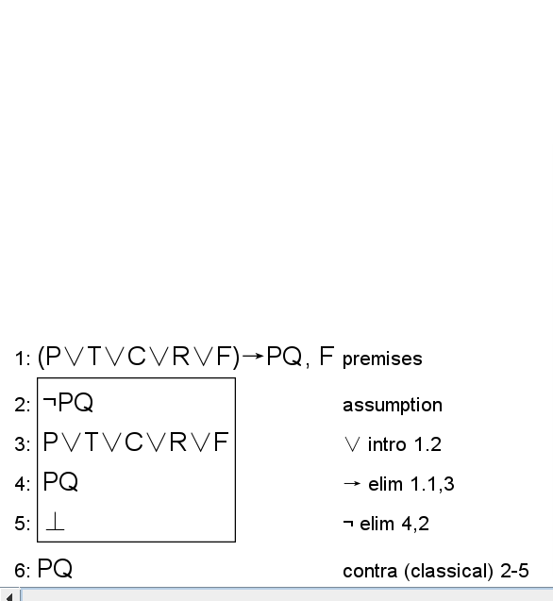

Slide 12
End

